Slide 1
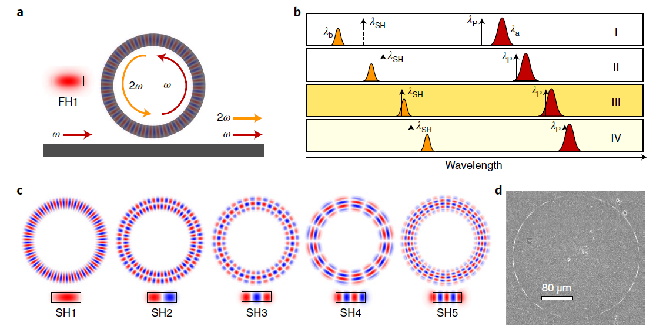
Setup
WDM
WDM
532nm in
532nm out
Quasi-phase-matching photo galvanic SHG
1064nm out
1064nm in
U taper
Microring
Heating by TEC
1064nm: pump, write grating
532nm: seed, monitor resonance match
Heater: align resonances of two wavelength
2022 Nature Photon.

Slide 2
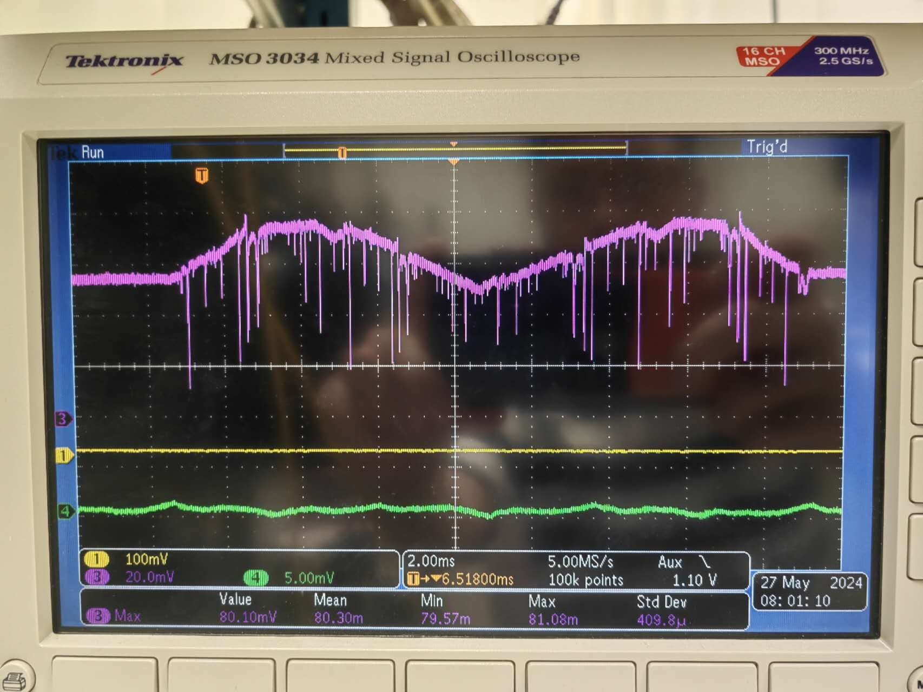
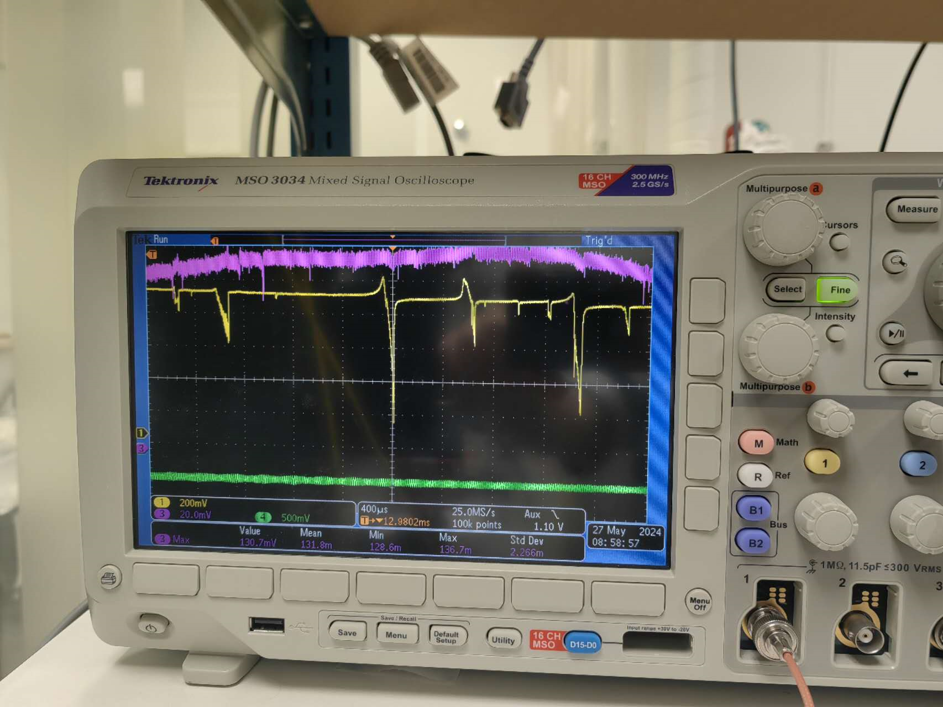
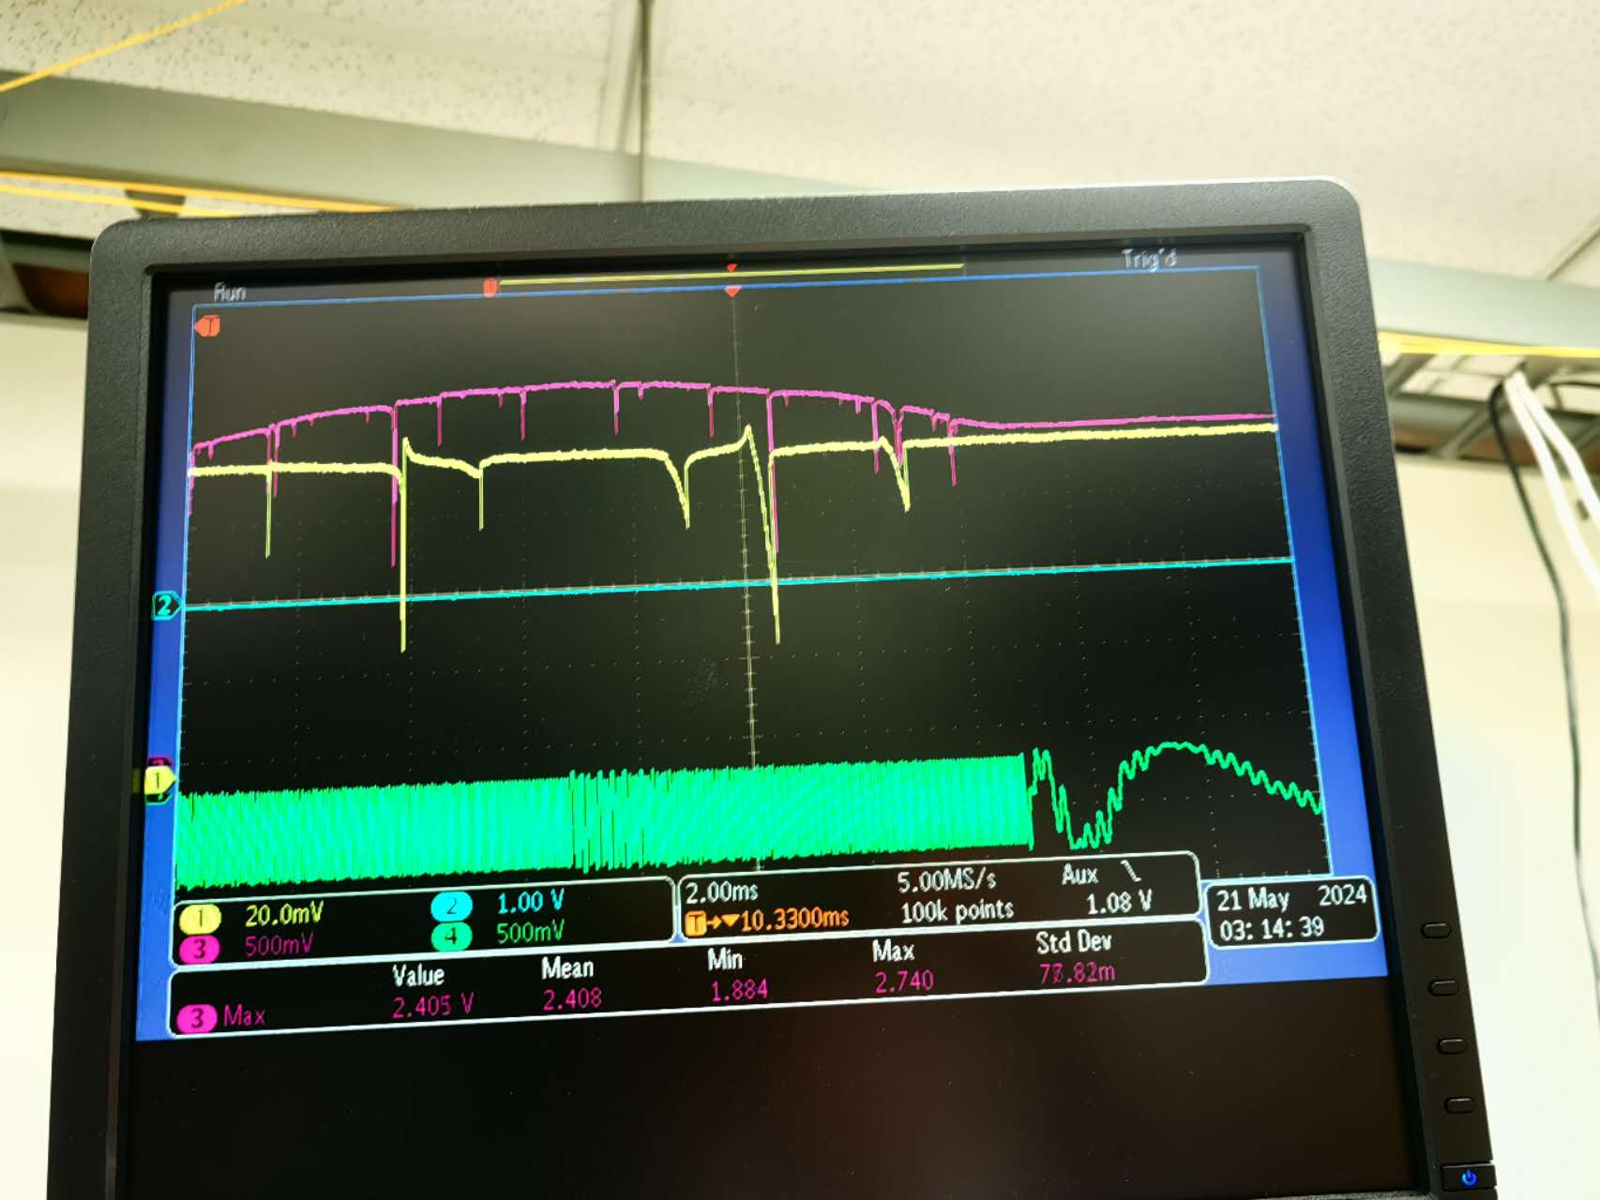
Coupling
Case1: near critical coupling at 1064nm (yellow trace), very weak coupling at 532nm (pink trace)
Case2: ~0.3 transmission dip for both wavelength
(1064 not shown in figure)

Slide 3
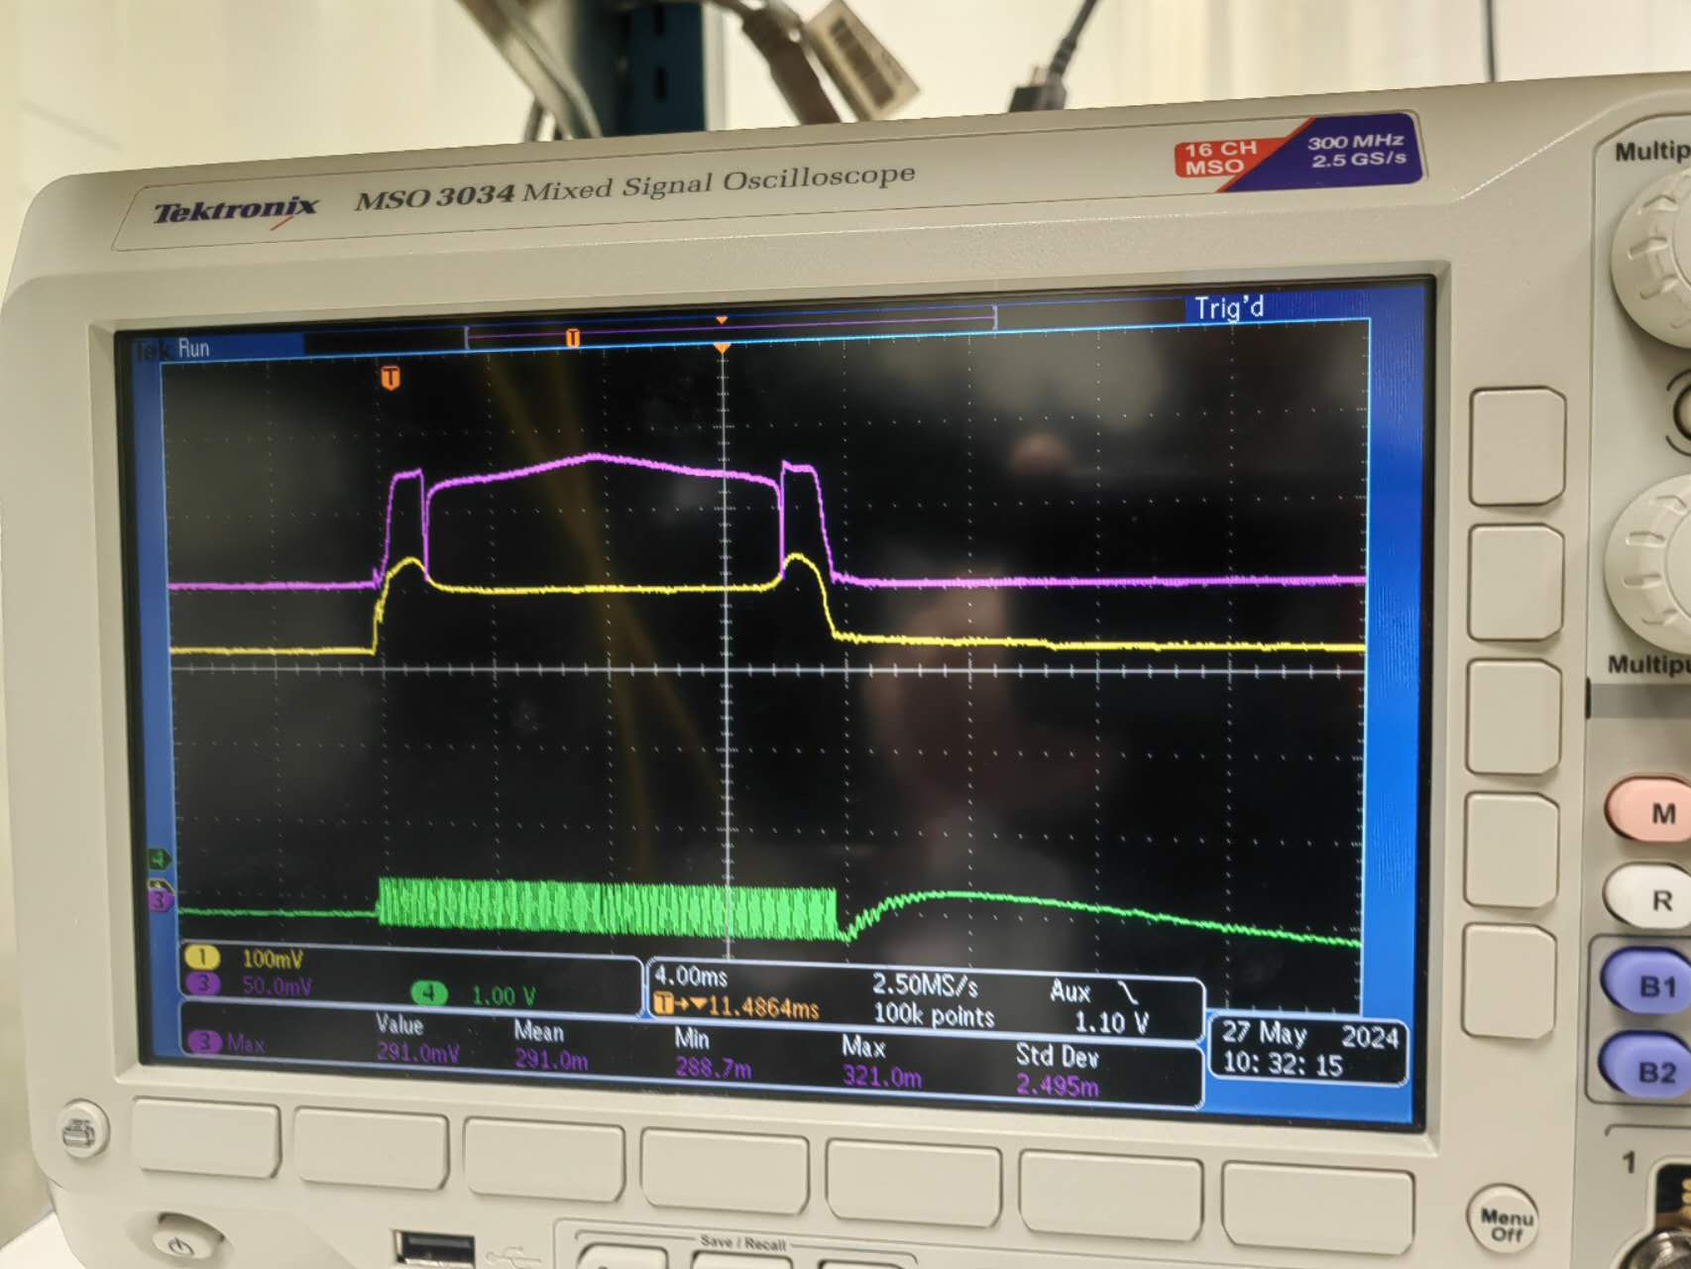
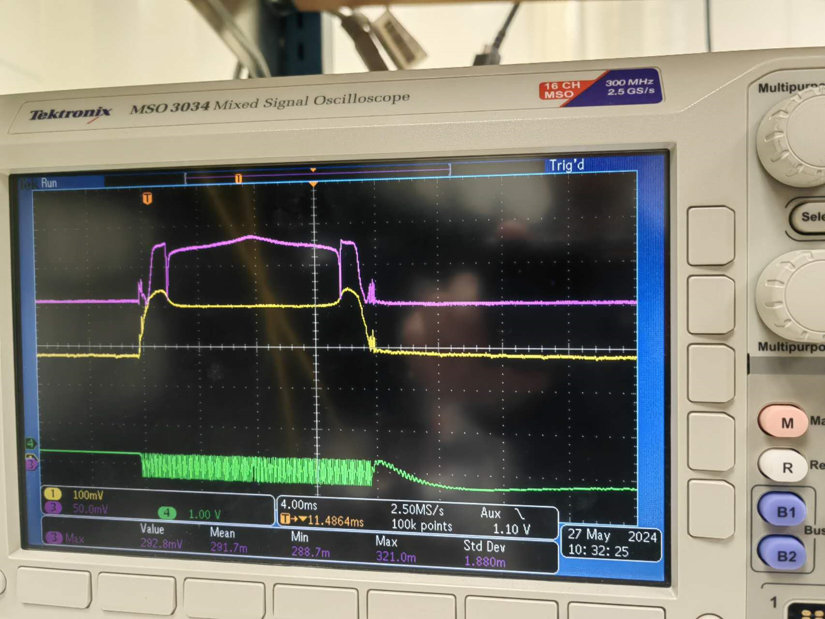
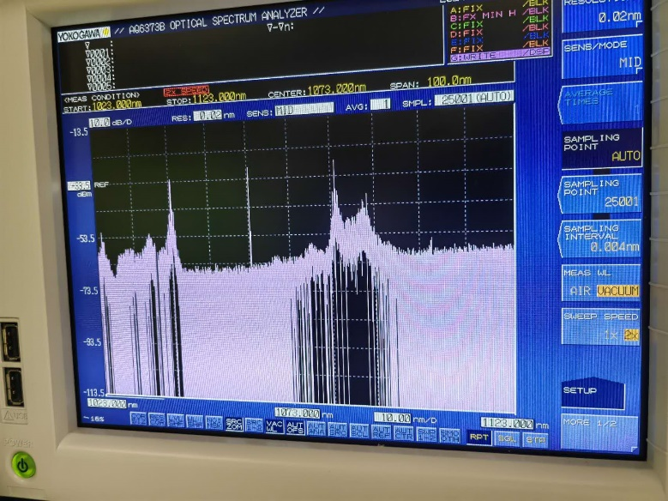
Align resonances and enter into them
Align resonances at two wavelengths by adjusting temperature carefully (0.01°C/step)
Wide waveguide: >6um width ring, normal dispersion; multiple modes, could not identify modes, overlap maybe small
Narrow waveguide: like 3um width ring, anomalous dispersion, FWM happen; single mode at 1064nm, could identify fundamental mode
Notes:
1064 on chip/U taper power> 100mW

Slide 4
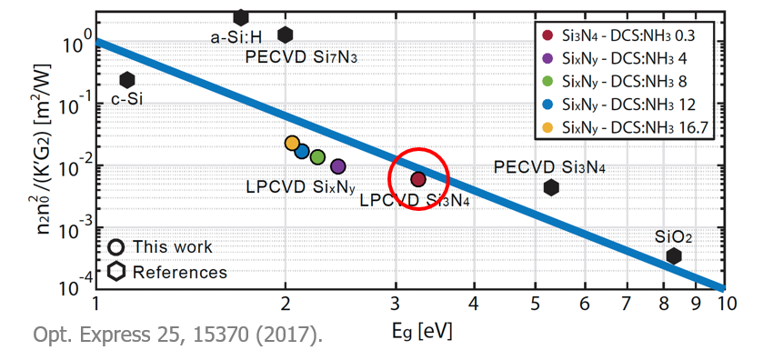
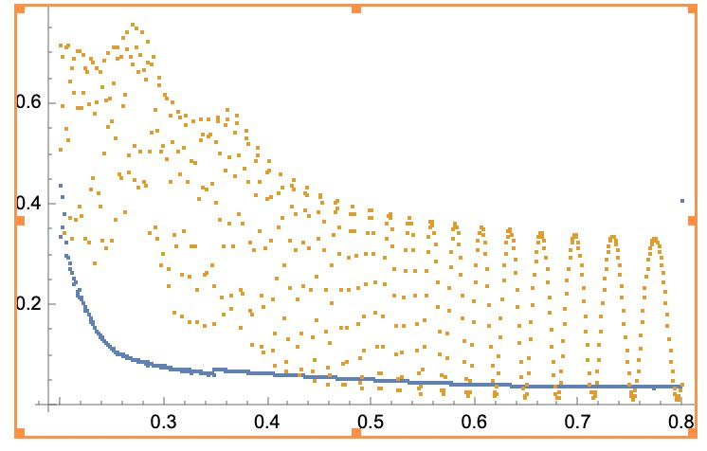
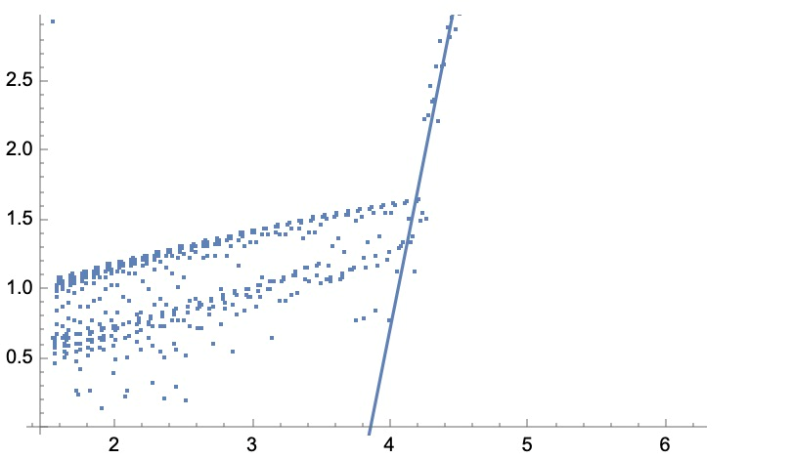
Bandgap measurement
Bandgap measurement by Jinyu
Early FHD: ~4.8eV
PECVD: some unknow problem, waiting for remeasurement
Different deposition may result in different bandgap

Slide 5
Device
25% doping PECVD (2% Δn): >50M at 1064nm, >20M at 532nm
45% doping FHD: >200M at 1064nm, > 40M at 532nm
No SHG observed on both platforms

Slide 6
Summary:
Potential problems:
Material bandgap
Mode overlapping
Coupling efficiency at both wavelength
Potential next plan:
Bandgap test of PECVD
New design1: single mode with normal dispersion at 1064nm
New design2: 1064nm and 532nm integrated couplers

